Slide 1


Slide 2
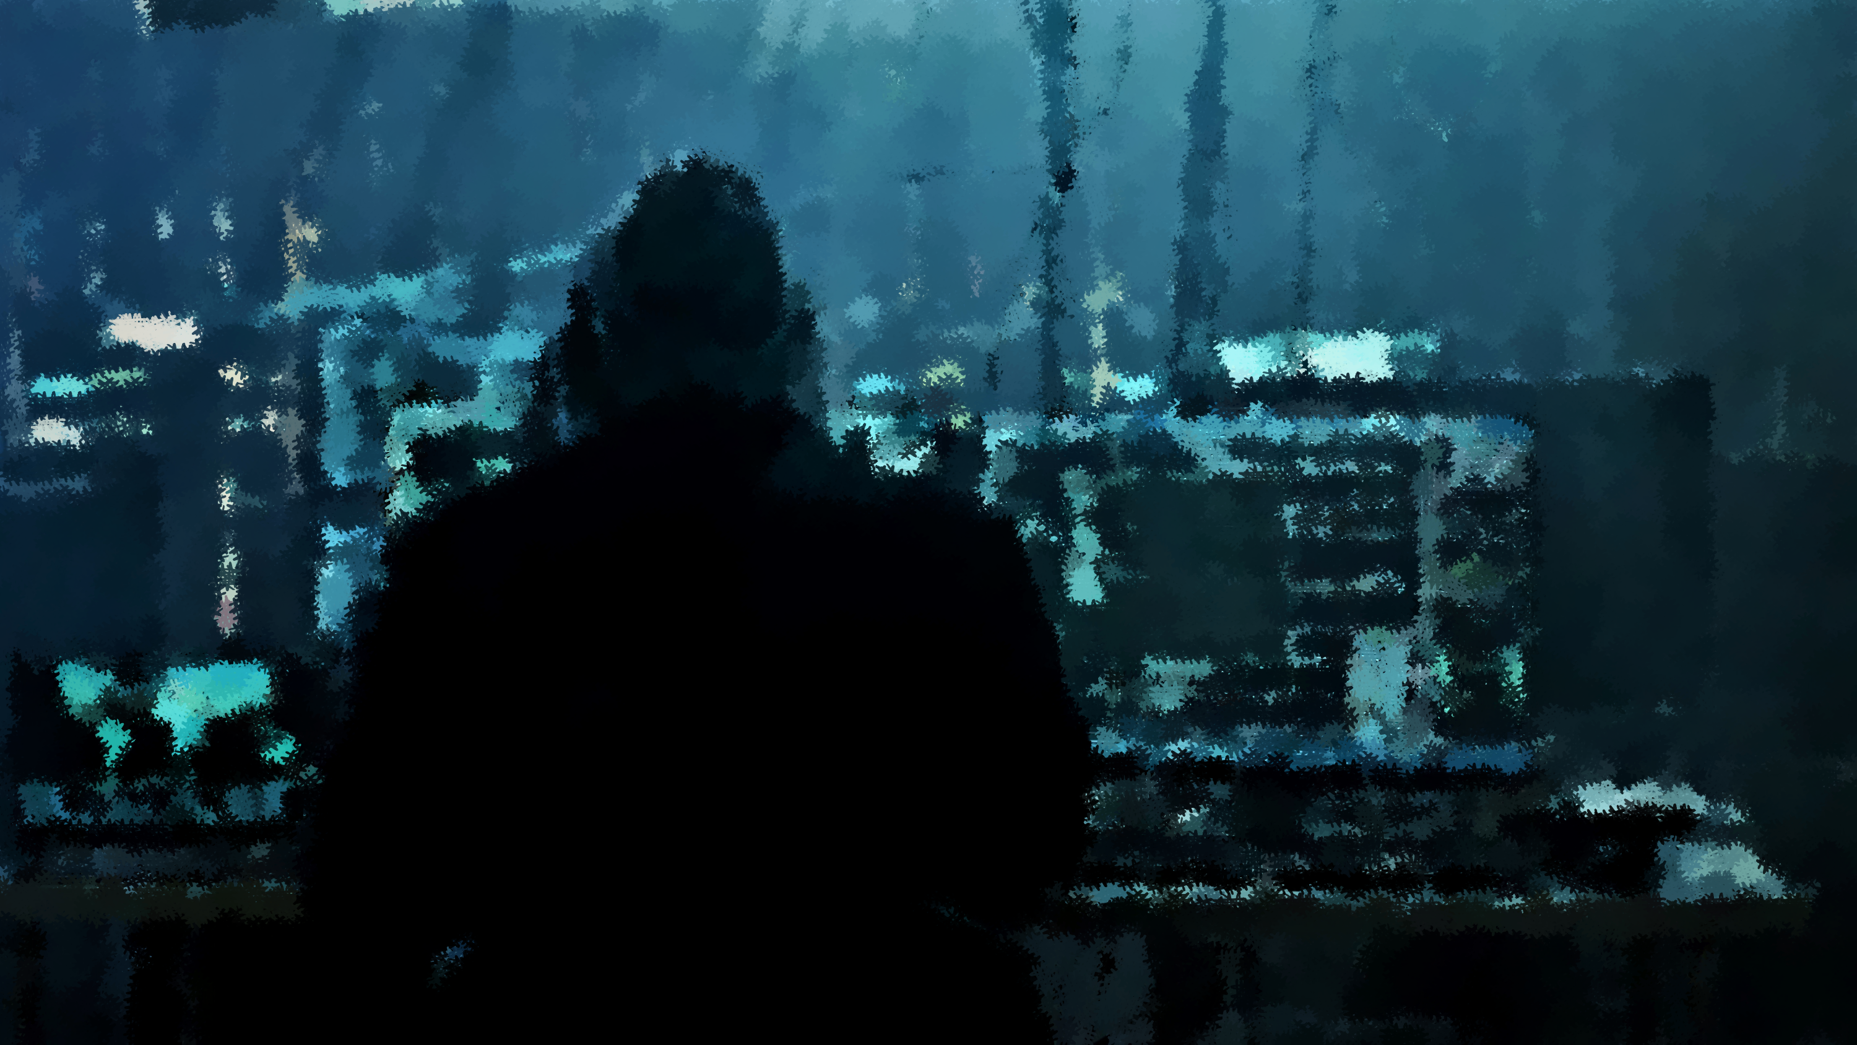
Cybersecurity: Protecting
the Digital Civilization
Banking, healthcare, education, energy, and government increasingly depend on software.
Our identity, data, and systems are entirely interconnected.
Therefore, attacking a computer system can mean attacking society itself.
-: MADE BY :-
Susanta Murmu
Surajit Badyakar
Shahil Rastogi

Slide 3



THE PARADOX OF DIGITAL CIVILIZATION
Technology Gives Us Power
And Massive Vulnerability
Modern architecture allows a single system or platform to serve millions of people simultaneously globally.
This scale creates a dangerous concentration of risk. One vulnerable system equals thousands or millions of affected users.
This unprecedented scale drives efficiency, rapid communication, and massive economic growth. It empowers individuals and nations alike.
•
Bank systems down: Financial disruption
•
Hospitals attacked: Patient care gets interrupted.
•
Government systems compromised: Public services halt
•
Critical infrastructure attacked: Physical consequences
The same technology that makes society more powerful can make society more vulnerable.

Slide 4




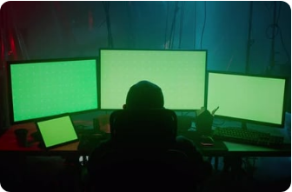



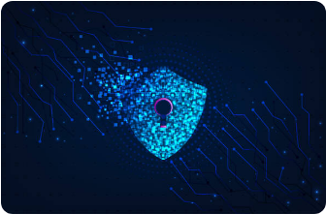
BEYOND "SOMEONE HACKED A COMPUTER"
The progression of threat impact: Individual → Company → Infrastructure → Society
Individual & Corporate
Infrastructure
Society at Large
Attacks induce panic over deleted accounts, stolen documents, compromised passwords, and lost connections. Includes Ransomware, Data Theft, and Identity Theft.
Espionage and supply-chain attacks target the core hardware and software backbones that companies and governments rely on to function daily.
State-sponsored cyber warfare. Cyberattacks are no longer just about stealing information; they are about disrupting, controlling, or manipulating societal systems.

Slide 5
Cyberspace can amplify the power of a small actor. A relatively small group with sophisticated capabilities can potentially attack organizations vastly larger than itself.
"
"
— This is why cybersecurity is a paramount national-security issue, shifting the traditional balance of power.

Slide 6






SECURITY VS. PRIVACY: DO WE HAVE TO CHOOSE?
Why should society accept the traditional trade-off? (More security = less privacy / More privacy = less security)
The False Dilemma
The Technological Solution
Modern Approaches
We are often told that to gain visibility and security against threats, we must sacrifice surveillance and privacy. Or, maintaining privacy leaves us blind to attacks.
Solutions include End-to-End Encryption, Privacy-preserving computation, Data minimization, and NLP-based secure identity/voice authentication.
Technology has the potential to break this paradox. We can engineer systems that provide both More Security and More Privacy simultaneously.

Slide 7
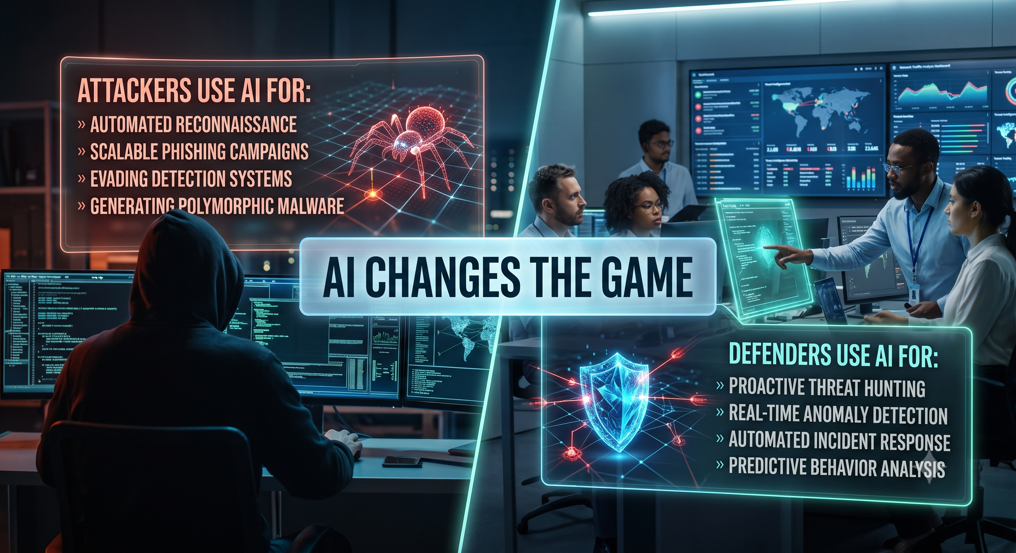
AI CHANGES THE GAME
The Attacker's Advantage
AI helps attackers find zero-day vulnerabilities, automate attacks at scale, generate sophisticated malicious code, and create highly convincing social engineering.
The Defender's Arsenal
Machine Learning (ML): Identifies unusual patterns in network traffic and user behavior (e.g., strange login attempts).
Predictive Analytics: Assesses the likelihood of future threats by analyzing historical data for proactive measures.
Automation: Frees professionals for strategic tasks.
A New Race: AI vs. AI. Who uses intelligence more effectively?

Slide 8
THE REAL PROBLEM: FRAGILE SYSTEMS
Don't focus only on stopping hackers. Ask: What happens when prevention fails? Perfect cybersecurity may be impossible; resilient cybersecurity is essential via Automated Incident Response.
Assume Attacks Will Happen
Build architectures expecting breach. Utilize AI to automatically isolate infected systems to prevent malware from spreading.
Limit the Damage
Implement AI-driven network segmentation to protect critical systems even if the outer perimeter is breached.
Detect Attacks Quickly
Continuously analyze global threat intelligence feeds with machine learning and NLP to spot anomalies instantly.
Recover Quickly & Patch
Use AI to help recover lost or corrupted data, and automatically patch vulnerabilities to avoid single points of failure.

Slide 9

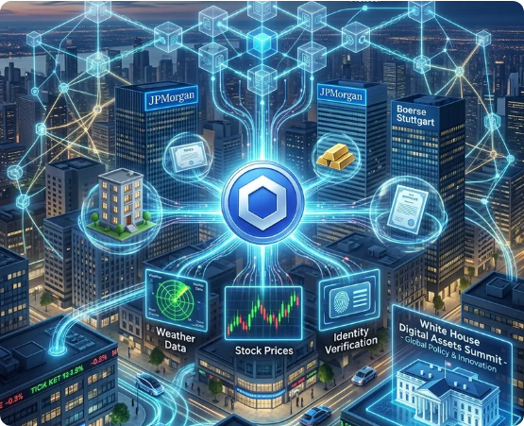
WHAT SHOULD WE BUILD?
Technology Solves the Problem
Instead of saying: “Technology is dangerous, so we need less technology.”
We must ask: “Can we build better technology?”
Future cybersecurity must combine:
AI + Cryptography + Privacy + Decentralization + Secure Infrastructure
Secure the rapidly expanding Internet.
Ensure ethical use of AI to protect people and systems.
The Goal: Powerful technology without fragile systems. Strong security without unnecessary loss of freedom.

Slide 10
CONCLUSION: SECURING THE FUTURE OF SOCIETY
The Reality
We have built a digital civilization that is incredibly powerful, yet fundamentally fragile.
The AI Imperative
As threats become automated, our defense must also be intelligent, adaptive, and predictive. We must leverage AI not just to react, but to anticipate.
The False Dilemma
We must reject the idea that we have to sacrifice privacy for security. The right technology can—and must—provide both.
The Mandate
Cybersecurity is no longer an IT checklist; it is the blueprint for our digital survival.
Final Call to Action
Let's stop just securing computers. It's time to build a digital civilization that is resilient, secure, and free.

